Slide 1
Do Now
Answer the questions below:
What is the ‘day of success’ that Macbeth refers to in his letter?
What does Lady Macbeth ‘fear’ about Macbeth?
What is the ‘golden round’?
Which guest is expected to arrive?
What is the religious significance of the serpent metaphor?

Slide 2
Do Now
Put the events below in order:
Macduff discovers Duncan’s body
Ross and the Old Man remark on the strange weather conditions
Macbeth looks down in despair at his bloody hands
Macbeth sees a floating dagger
Lady Macbeth faints

Slide 3
Do Now
Find short quotations to support the statements below:
Macbeth is ambitious
Macbeth feels conflicted
Macbeth is violent

Slide 4
Do Now
Find the page numbers for the events below:
The witches first appear on stage
Duncan decides to reward Macbeth by making him Thane of Cawdor
The witches prophecise that Banquo’s sons will be kings
Duncan names Malcolm as his successor
Macbeth realises that he will not become king without direct action
Lady Macbeth reflects that Macbeth is not ruthless enough to murder Duncan
Macbeth sees a floating dagger
Macbeth regrets murdering Duncan

Slide 5
Do Now
Retrieve short quotations:
Duncan asks if the treacherous Thane of Cawdor has been executed (A1-S4)
Duncan names Malcolm as his successor (A1-S4)
Macbeth concedes that Duncan is a good king (A1-S7)
Macbeth regrets murdering Duncan (A2-S2)
Macduff reacts with shock and horror to the murder of Duncan (A2-S3)

Slide 6
Do Now
Copy and complete at least two of the sentences below:
Macbeth’s presentation as a hero changes when…
The appearance of the witches is significant because…
The regret that Macbeth feels after murdering Duncan is emphasised by…
The stormy weather on the night of Duncan’s murder builds tension, but also…

Slide 7
Do Now
Find the page numbers for the events:
Banquo and Macbeth are compared to powerful cannons (A1-S2)
Banquo remarks on the appearance of the witches (A1-S3)
Banquo notices that Macbeth seems intrigued by the prophecies (A1-S3)
Macbeth and Banquo are praised by Duncan (A1-S4)
Banquo first hears the news of Duncan’s death (A2-S3)

Slide 8
Do Now
Answer the questions :
Who was King of England and Scotland when the play was first performed?
What is Macbeth’s tragic flaw?
What irreversible act does Macbeth commit that is responsible for his downfall?
What do the witches prophecise about Banquo?
What is the name of Duncan’s eldest son?
What does Macbeth return with in his hands after murdering Duncan?
Which character first discovers Duncan’s body?
What do Ross and the Old Man notice about the weather after Duncan’s murder?

Slide 9
Do Now
Fill-in the gaps:
How far is’t call’d to Forres? What are these
So __1__ and so __2__ in their attire,
That look not like the __3__ o’ the earth,
And yet are on’t? Live you or are you aught
That man may question? You seem to understand me,
By each at once her __4__ finger laying
Upon her __5__ __6__: you should be __7__,
And yet your __8__ forbid me to interpret
That you are so.

Slide 10
Recap
Copy and complete the quotations below:
‘Come thick ____ and pall thee in the ____ smoke of ____’
‘Nor heaven peep through the ____ of the ____’
‘A foolish thought to say a ____ ____’
‘My ____ are of ____ colour; but I ____ to wear a ____ so ____’
‘When all’s done, you ____ but on a ____’
‘Fie for ____!’
‘You lack the ____ of all natures, ____’

Slide 11
Do Now
Identify and correct the eight errors in the passage below:
Unlike the treasonous macbeth, Macduff is completely loyal to Duncen and his son Malcolm. He discovers Duncans body, and he soon becomes suspisious of Macbeth. Fearing Macbeths vengeance, he flees to England to support Malcom in his assault on Macbeth. However this leaves his castle, wife and children undefended and vunerable.

Slide 12
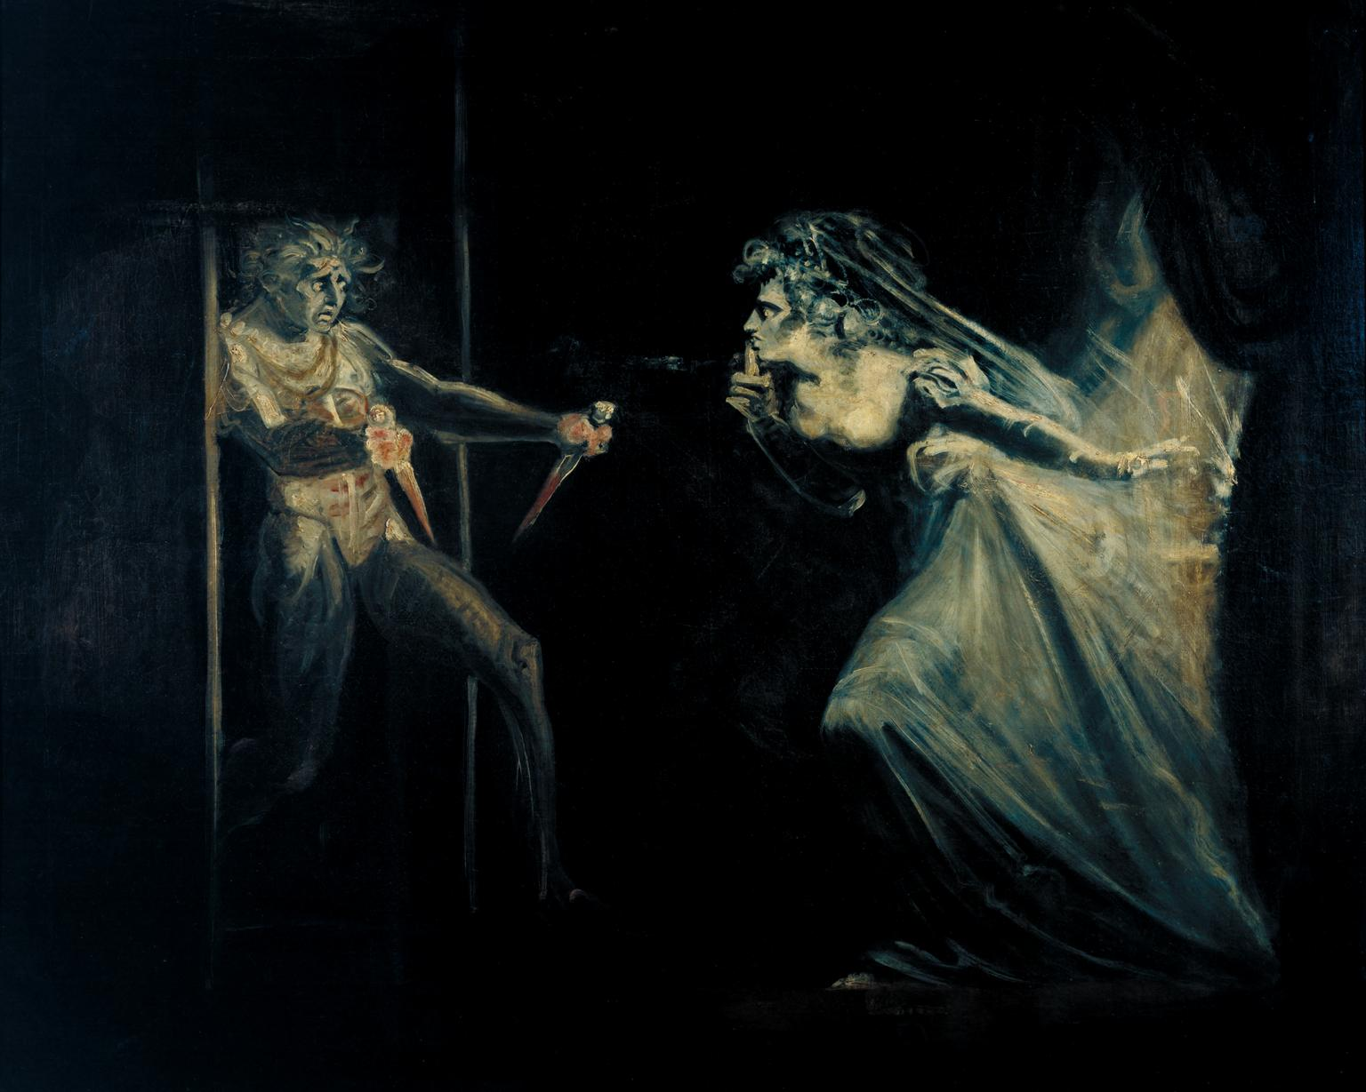
Do Now
Identify the act and scene:

